Slide 1
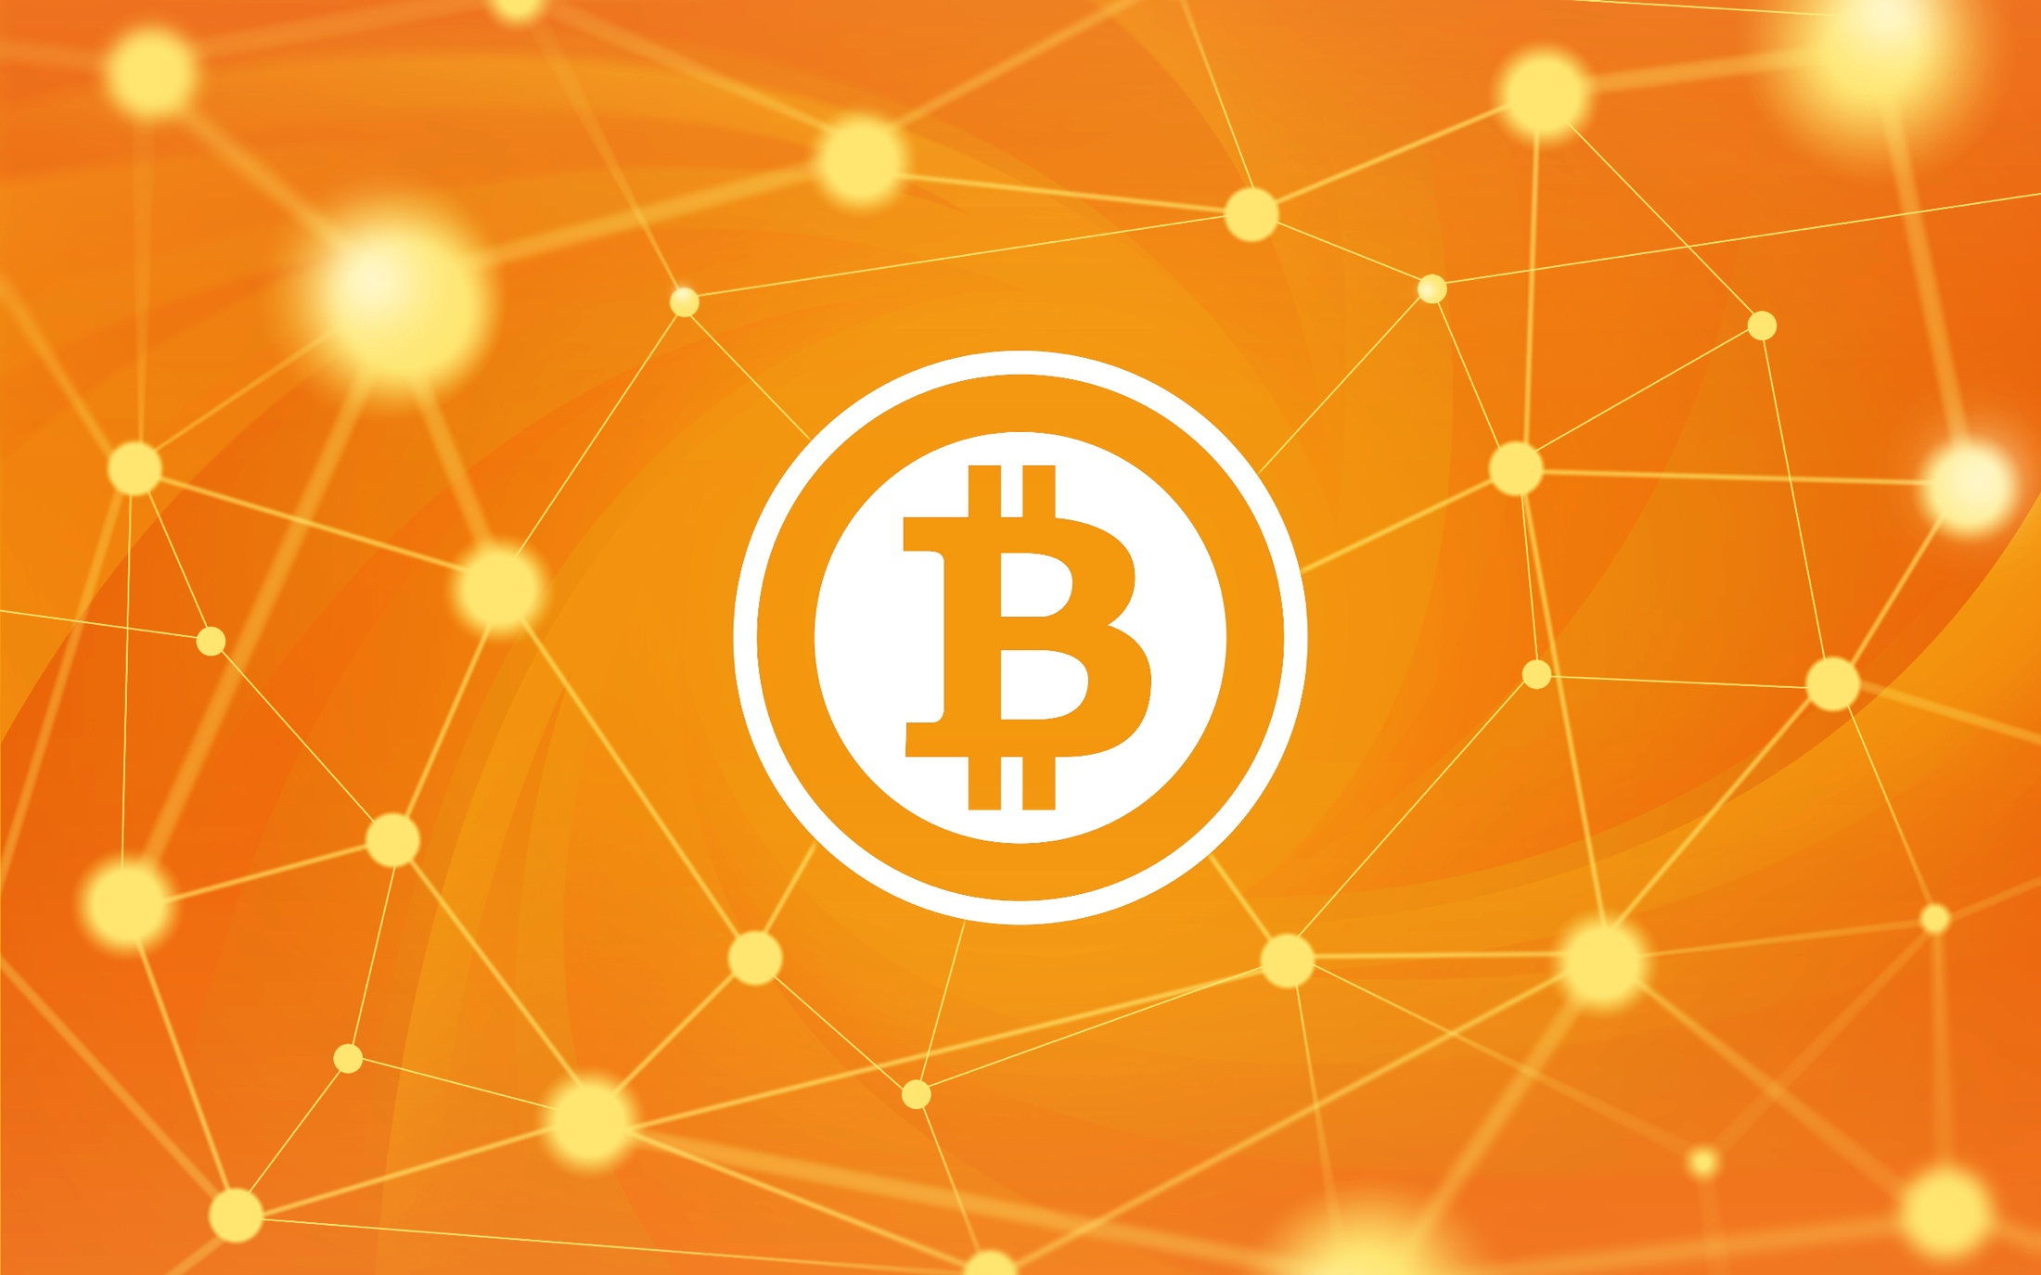
Bitcoin
CSCI 3250 Computer Society

Slide 2
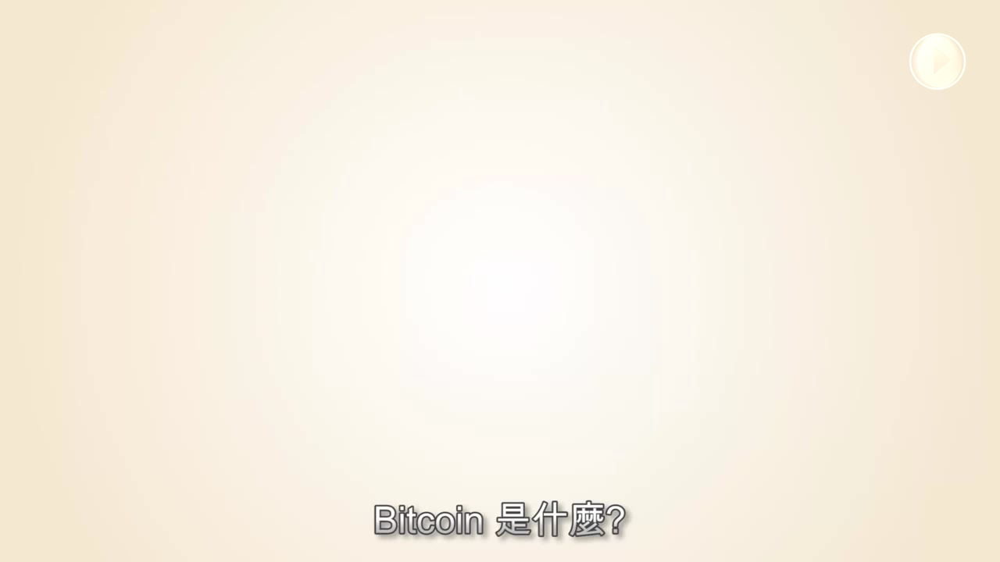
What is Bitcoin? https://www.youtube.com/watch?v=BIyj4qe1wQM
Prelude

Slide 3


Introduction

Slide 4


What
Decentralized Crytocurrency
Bitcoin
bitcoin (BTC)
Technology / Network
common unit of currency

Slide 5


Who & When
?
中本聰
Satoshi Nakamoto
Oct 31, 2008
<Bitcoin: A Peer-to-Peer Electronic Cash System>
Dan Kaminsky (security researcher):
either be a "team of people" or a "genius"
Jan 03, 2009
Block 0: The Genesis Block

Slide 6
Advantages

Slide 7



Technology
Internet
Great computational power
Security
SHA256 (message)
RIPEMD-160 (address) Public-key cryptography
Pear to Pear (P2P)
Each node: Client & Server

Slide 8



Decentralize
Decentralized currency
Everyone can create bitcoin (mining)
Everyone verify transactions
Little/no transaction fee
the algorithm controls the money supply
Centralized currency
1 country, 1 Central bank Bank verify all transactions
Transaction fee
an Authority controls the money supply

Slide 9


Anonymity
Amonymous
Transaction records : always traceable
Identity behind transaction: NOT always
Known
Account ←→ personal information
Easy to trace

